Slide 1
Rule 9.2 Submission for the 1459th meeting of the Committee of Ministers in the Öner and Türk Group (Appl. No. 51962/12) Nedim Şener Group (Appl. No. 38270/11) Altuğ Taner Akçam Group (Appl. No. 27520/07) Artun and Güvener Group (Appl. No. 75510/01) Işıkırık Group (Appl. No. 41226/09)
Mümtaz Murat Kök
27 February 2023

Slide 2
Groups of cases
Application no. | Group of cases | Judgment Date (leading case) | Finalization date (leading case) | Source of violation / the violation
27520/07 | Altuğ Taner Akçam Group | 25/10/2011 | 25/01/2012 | TPC Article 301 / (Article 10 of the Convention)
75510/01 | Artun and Güvener Group | 26/06/2007 | 26/09/2007 | TPC Articles 125 and 299 / (Article 10 of the Convention)
41226/09 | Işıkırık Group | 14/11/2017 | 09/04/2018 | TPC Article 220/6- 7 / (Articles 10 and 11 of the Convention)
38270/11 | Nedim Şener Group | 08/07/2014 | 08/10/2014 | CCP Article 100 / (Articles 5 and 10 of the Convention)
51962/12 | Öner and Türk Group | 31/03/2015 | 30/06/2015 | ATL Articles 6-2, 7-2 & TPC Articles 215, 216 / (Article 10 of the Convention)
TPC = Turkish Penal Code
ATL= Anti- Terror Law
CCP= Code on Criminal Procedures
Notes:
However, in this briefing we hope to illustrate that problems raised in these groups persist in an increasingly arbitrary and punitive manner.

Slide 3
Brief summary of the authorities’ claims and arguments
Öner and Türk Group of Cases
Article 6/2 of Anti-Terror Law : Printing or publishing declarations or announcements of terrorist organizations
Amended in 2013 → «the interpretation has been narrowed down through a remark added and thus the act of printing and publishing leaflets is no longer considered an offense unless they praise or incite terrorist organization’s methods and involve elements of violence, force or threat.»
Article 7/2 of Anti- Terror Law : Propaganda in favor of an illegal organization
Amended in 2013 → «the interpretation has been narrowed down the act of making propaganda for a terrorist organization by justifying, praising or inciting its methods, is not recognized as an offense if it does not contain violence, force or threat. »
A sentence added in 2019 → «expressions of opinion constituting criticism or not exceeding the limits of reporting, will not constitute a crime.»
Article 215 of the Turkish Penal Code: Praising an offense or an offender
Amended in 2013 → «the sentence ‘provided that there emerges an imminent and clear danger to the public order’ was added to the article. This has brought the article in line with the Convention.»
Article 216 of the Turkish Penal Code: Provoking the public to hatred, hostility, denigrating a section of the public
no amendment → Despite the Committee’s 2008 assessment and the Venice Commission’s 2016 opinion.

Slide 4
Brief summary of the authorities’ claims and arguments
Nedim Şener Group of Cases
Concerns pre-trial detention of journalists on serious charges (offenses against the constitutional order and its functioning and establishing organizations for the purpose of committing crimes) and as per Article 100 of Code of Criminal Procedure
No amendment, no progress
«Nobody has a privilege to commit a crime under the pretext of journalism (para. 349)» ( Action Report -07/01/2022)
«Some persons are indicated as journalist merely on the basis of their self-declaration without further examination» and thus cannot be considered as «journalists in prison» ( Action Report -07/01/2022)
«Journalism activities cannot be per se subject to an investigation in Türkiye» (Action Plan - 05/01/2023)
«Nobody is held in the penitentiary institutions due to their journalistic activities but because of their criminal activities» (Action Plan - 05/01/2023)

Slide 5
Brief summary of the authorities’ claims and arguments
Altuğ Taner Akçam Group of Cases
Article 301 of the Turkish Penal Code: degrading the Turkish Nation, State of Turkish Republic, the Organs and Institutions of the State
amended in 2008 → 1) a clause has been added to the article indicating that “expression of an opinion for the purpose of criticism does not constitute an offense.” 2) the authorization of the Minister of Justice to conduct an investigation into an offence regarding Article 301 was adopted as a filtering measure.
The authorities claim that these measures narrowed down the interpretation of the article.

Slide 6
Brief summary of the authorities’ claims and arguments
Artun and Güvener Group of Cases
Article 125 of the Turkish Penal Code: insulting
No amendment
2005 amendment must be noted which amended two clauses of the article : (4- openly insulting) and (5- insulting public officials working as a committee). Both of which increase the stipulated prison sentence.
Article 299 of the Turkish Penal Code: insulting the president
No amendment → The authorities claim that the requirement of the Ministry of Justice authorization for prosecution (NOT investigation) («filtering mechanism») has «eliminated the concerns.»
BUT 2005 amendment must be noted which amended the second clause of the article (2- openly) and increased the stipulated prison sentence.

Slide 7
Brief summary of the authorities’ claims and arguments
Işıkırık Group of Cases
Article 220/6 of the Turkish Penal Code: Committing an offense on behalf of an organization without being a member
2012 Amendment → The provision “The sentence to be imposed for being a member of an organization may be reduced by half” was added.
The sentence "This provision shall only be applied in respect of armed organizations” added to the clause. The authorities claim that these amendments fixed the problem of broad application.
Article 220/7 of the Turkish Penal Code: Aiding and abetting an organization willingly and knowingly without belonging to its structure
2012 Amendment → The provision ‘The sentence to be imposed for being a member of an organization may be reduced by half” was added.
The authorities further claim that the scope of these clauses have been further narrowed down through an amendment to the Anti-Terror Law in 2013 which added a clause (5) to Article 7 of the Anti-Terror Law stating that “Any person who commits the following offences on behalf of a terrorist organization without being a member of it shall not be separately punished for the offence described in the sixth paragraph of Article 220 of the Law no.5237 [Turkish Penal Code]”

Slide 8
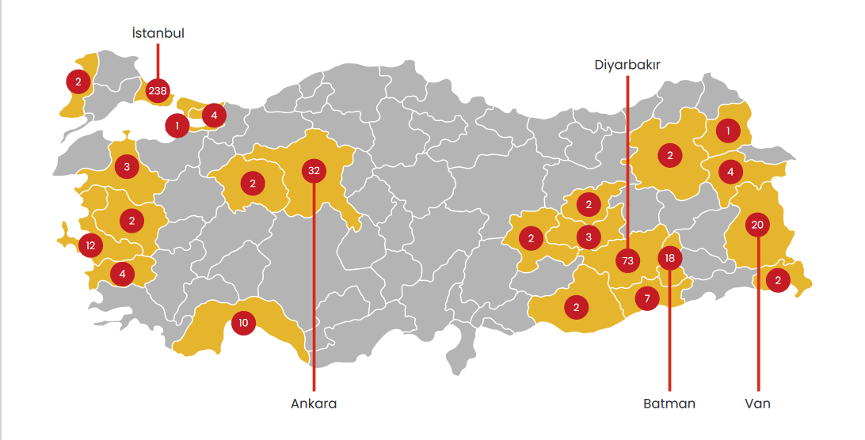
Current situation

Slide 9
Current situation
Öner and Türk Group of Cases
Article 6/2 of Anti-Terror Law : Printing or publishing declarations or announcements of terrorist organizations)
In its entirety, Article 6 of Anti-Terror Law continues to be a source of violations.
Despite the claims of the authorities, the trials based on Article 6/2 of Anti-Terror Law continue and they constituted 1,7% of the charges during the monitoring period.
Prolonged trials and violations of the right to fair trial. For instance; journalist Reyhan Çapan has been on trial on this charge since 2014. Similarly exiled journalist Can Dündar has been on trial on this charge since 2016.
On 18 May 2022, in a separate lawsuit, journalist Reyhan Çapan was sentenced to 1 year and 6 months in prison on Article 6/2.
Article 6/1 of Anti-Terror Law: Disclosing or publishing the identity of officials on anti-terrorist duties, or identifying such persons as targets
The ambiguous wording of Article 6/1 makes it possible for any public official (even retired ones) to be defined as “an official on anti-terrorist duties.”
As the cases during the monitoring period exemplify, this person can be a police officer, a retired military commander who was accused of raping a woman called Şükran Aydın in 1993 and was a leading figure in the violation judgment of the Court in the case of Aydın v. Turkey (1997), the head of the Presidency’s Directorate of Communications, a prosecutor who was accused of failing to carry out an effective investigation in a racially motivated murder case.

Slide 10
Current situation
Öner and Türk Group of Cases
Article 7/2 of Anti- Terror Law: Propaganda in favor of an illegal organization)
Article7/2 charges, which were among the charges leveled against individuals in 62 cases, constituted 54% of the terrorism-related charges in this period. In 46 of these trials, journalists were the defendants.
This picture clearly demonstrates that amendments and especially the 2019 addition to the article in no way protect the freedom of criticism or the press.
Though it is not included in the monitoring period, I wish to share with you today the example of Professor Şebnem Korur Fincancı.

Slide 11
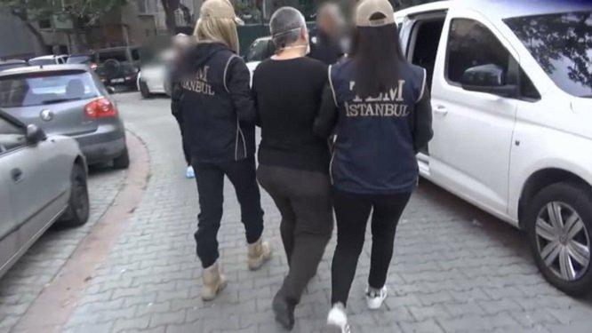
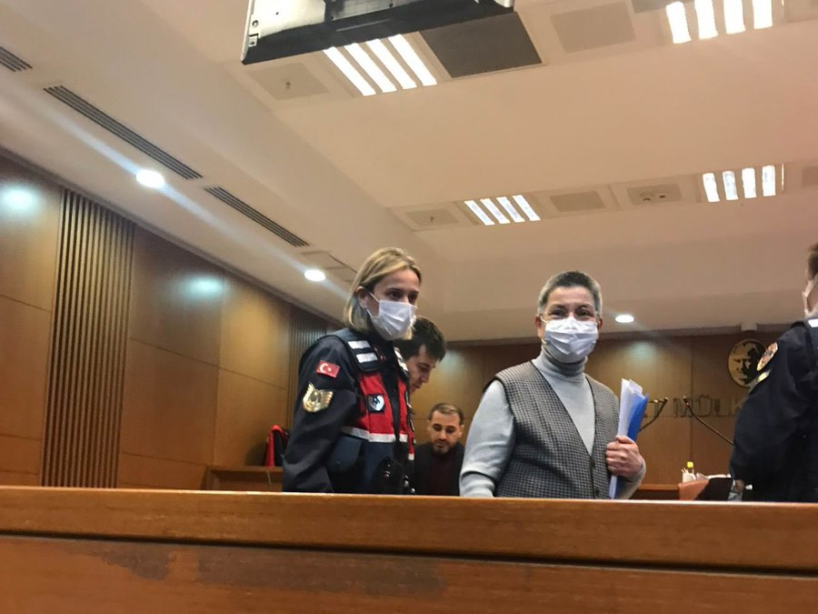
Current situation
Öner and Türk Group of Cases
Article 7/2 of Anti- Terror Law: Propaganda in favor of an illegal organization)
Also a prominent human rights defender, Şebnem Korur Fincancı, the head of the Turkish Medical Association was arrested on 27 October 2022 over the suspicion of “propaganda in favor of an illegal organization.” Korur Fincancı kept in pre-trial detention for 76 days.
Eventually, on 11 January 2023, Korur Fincancı was sentenced to 2 years 8 months and 15 days in prison for “propaganda in favor of an illegal organization” and was released pending appeal.

Slide 12
Current situation
Öner and Türk Group of Cases
Prison sentences
Occupation | Name | Sentence
Lawyer | Nurcan Kaya | 1 year 3 months
Author | Meral Şimşek | 1 year 3 months
Artist | Mehmet Özer | 1 year 3 months
Journalist | Vedat Örüç | 1 year 6 months 22 days
Journalist | Nurcan Yalçın | 1 year 6 months 22 days
Author | Erdal Yıldırım | 1 year 6 months 22 days
Journalist | Gülşen Koçuk | 1 year 10 months 15 days
Journalist | Rojhat Doğru | 1 year 3 months
Journalist | Nazan Sala | 1 year 3 months

Slide 13
Current situation
Öner and Türk Group of Cases
Prison sentences
Occupation | Name | Sentence
Activist | Serkan Zorlu | 10 months
Politician | Ramazan Güney | 2 years 1 month
Journalist | Selda Manduz | 1 year 6 months 22 days
Journalist | Durket Süren | 1 year 6 months 22 days
Journalist | Zekine Türkeri | 1 year 6 months 22 days
Journalist | Çetin Yılmaz | 1 year 6 months 22 days
Newpaper distributor | Ercan Yeltaş | 7 months 15 days
Newspaper distributor | Veysi Altın | 7 months 15 days
Press Consultant | Vedat Dağ | 1 year 6 months 22 days
Journalist | Abdurrahman Gök | 1 year 6 months 22 days

Slide 14
Current situation
Öner and Türk Group of Cases
Article 215 of the Turkish Penal Code: Praising an offense or an offender
The 2013 amendment to the Article 215 of the Turkish Penal Code has not solved the problems with the article and most importantly the problem of “unforeseeability” the Court had found in the case Yasin Özdemir v. Turkey. Individuals can still be charged and sentenced for their expressions which do not pose “an imminent and clear danger to public order.”
The lawsuit brought against journalist Cengiz Çandar and activist Kemal Işıktaş proves this point.
Indictment filed in 2020 cited social media posts shared in 2017 as evidence for the charges.

Slide 15
Current situation
Öner and Türk Group of Cases
Article 216 of the Turkish Penal Code: Provoking the public to hatred, hostility, denigrating a section of the public
In their latest action plan, the authorities failed to inform the Committee about the progress or more appropriately the lack of progress regarding Article 216 of the Turkish Penal Code.
The article, however, is used more and more to stifle freedom of expression.
Examples of popstar Gülşen and journalist Mehmet Güleş demonstrate such tendency

Slide 16
Current situation
Öner and Türk Group of Cases
Article 216 of the Turkish Penal Code: Provoking the public to hatred, hostility, denigrating a section of the public
On 25 Augusts 2022, popstar Gülşen was arrested after an organized social media campaing and kept in pre-trial detention for 4 days.
On 8 February 2023, journalist Mehmet Güleş was taken into police custody in Diyarbakır because of an interview with a search & rescue volunteer.

Slide 17
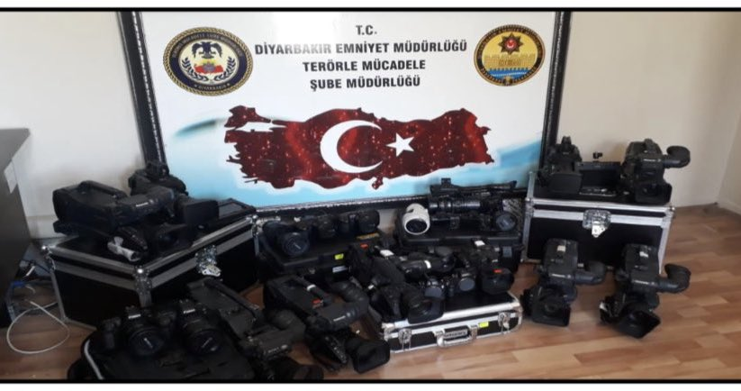
Current situation
Nedim Şener Group of Cases
Concerns pre-trial detention of journalists on serious charges (offenses against the constitutional order and its functioning and establishing organizations for the purpose of committing crimes) and as per Article 100 of Code of Criminal Procedure
Currently at least 61 journalists in prison. 26 out of 61 are in pre-trial detention.
Over the past 9 months, 26 journalists have been arrested over the suspicion of «membership in a terrorist organization (Article 314 of TPC and Article 7-1 of ATL)

Slide 18
Current situation
Nedim Şener Group of Cases
On 16 June 2022, 16 journalists arrested in Diyarbakır

Slide 19
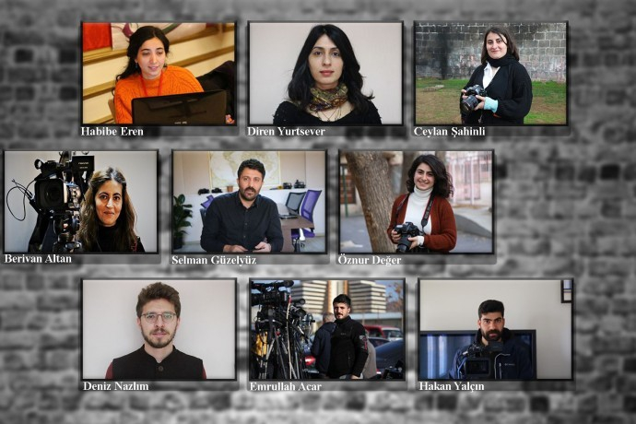
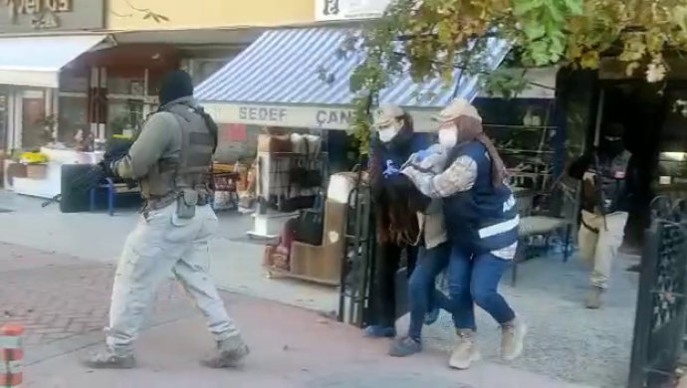
Current situation
Nedim Şener Group of Cases
On 29 October 2022, 9 journalists arrested in Ankara

Slide 20
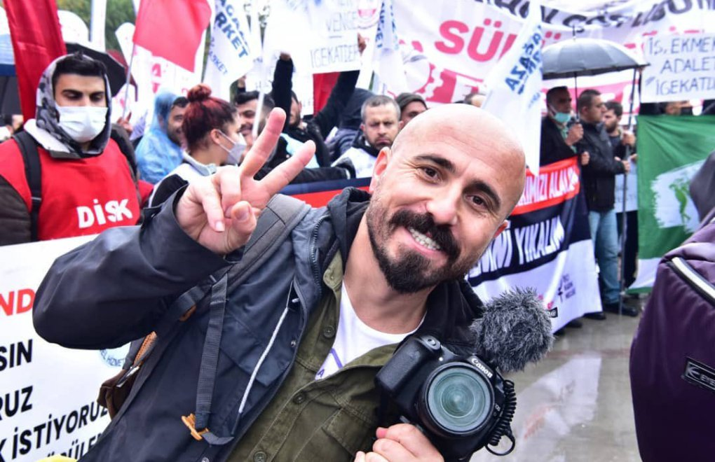
Current situation
Nedim Şener Group of Cases
On 10 January 2023, journalist Sezgin Kartal arrested in Istanbul

Slide 21
Current situation
Altuğ Taner Akçam Group of Cases
Article 301 of the Turkish Penal Code: Degrading the Turkish Nation, State of Turkish Republic, the Organs and Institutions of the State
Contrary to the claims of the authorities, the 2008 amendment to the Article 301 has not solved the problems and thus the article continues to be a source of further violations.
During the monitoring period 25 people, including lawyers, journalists and politicians stood trial on this charge.
Perhaps the most striking example in this regard is the continuous legal harassment of the Diyarbakır Bar Association

Slide 22
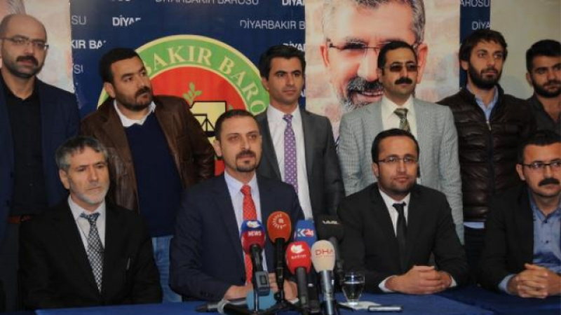
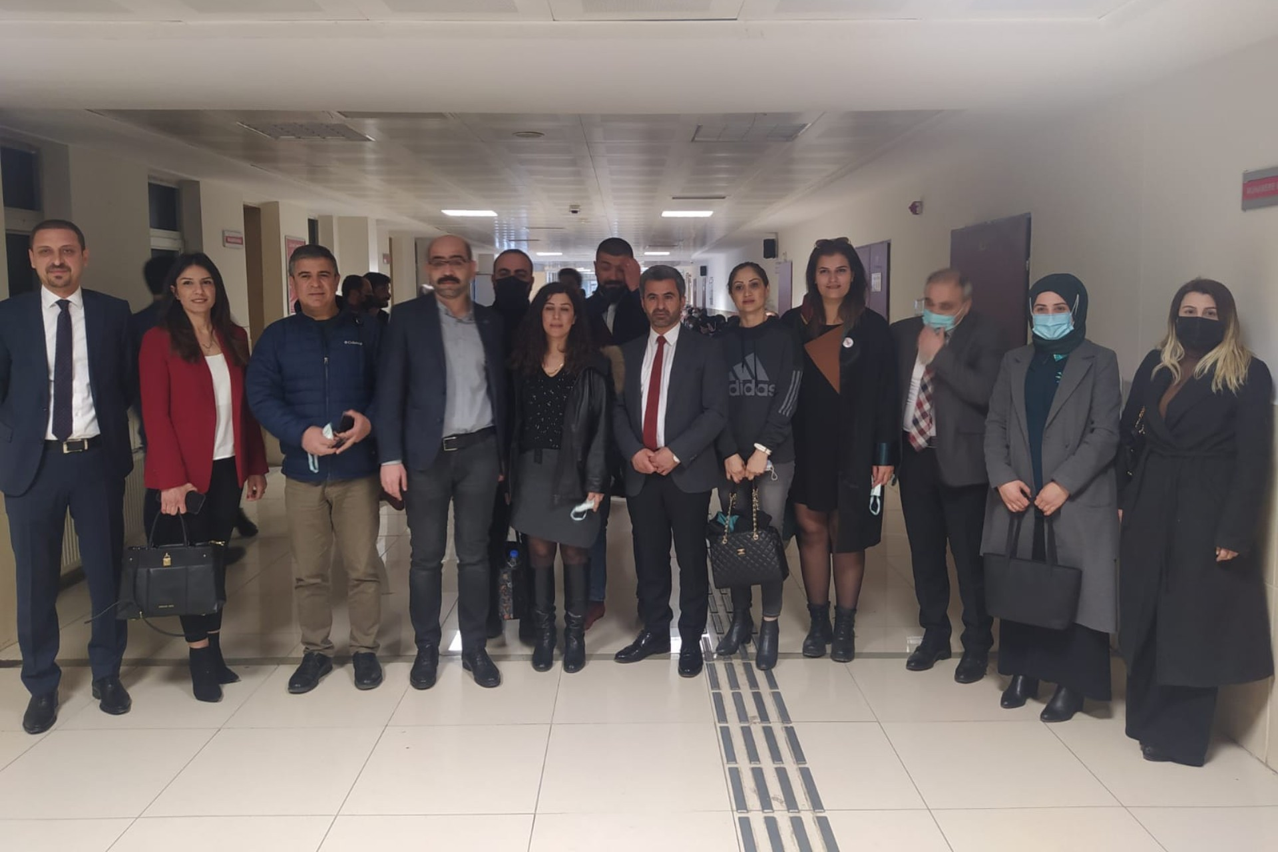
Current situation
Altuğ Taner Akçam Group of Cases
Article 301 of the Turkish Penal Code: Degrading the Turkish Nation, State of Turkish Republic, the Organs and Institutions of the State
The Diyarbakır Bar Association is repeatedly charged with “degrading the Turkish Nation, State of Turkish Republic, the Organs and Institutions of the State (Article 301)” because of the Association’s annual press statements on the Armenian Genocide.

Slide 23
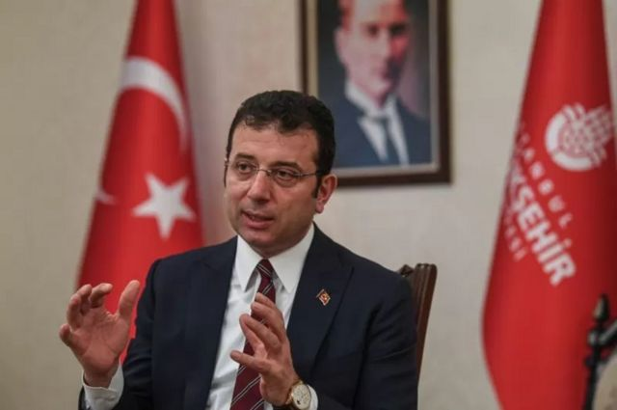
Current situation
Artun and Güvener Group of Cases
Article 125 of the Turkish Penal Code: Insulting
Contrary to the claims of the authorities, there is no “Convention compliant attitude” when it comes to the application of Article 125.
MLSA recorded that during the monitoring period 73 people, including journalists, lawyers, activists and politicians stood trial on these charges. The majority of the insult charges were “insulting a public official. (Article 125/3a)”
Perhaps the most popular and troubling recent example of this tendency is the 2 years and 7 months prison sentence imposed upon the Istanbul Mayor Ekrem İmamoğlu for “insulting public officials who work as part of a committee because of their duties. (Article 125/5).”

Slide 24
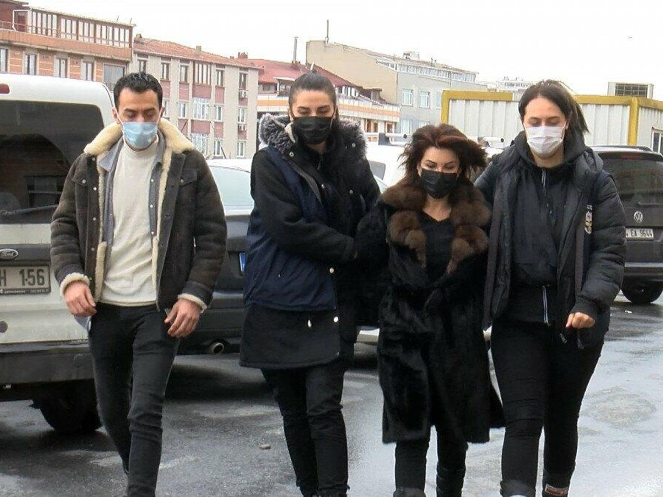
Current situation
Artun and Güvener Group of Cases
Article 299 of the Turkish Penal Code: Insulting the president
Contrary to the claims of the authorities that all the concerns regarding Article 299 have been eliminated through a “filtering measure” and Convention compliant case law, the article is applied in absolute defiance of the Vedat Şorli judgment of the court to punish criticism and stifle freedom of expression.
Furthermore, Article 299 of the Turkish Penal Code increasingly gives way to Article 5 violations as it can be seen in the examples of journalist Sedef Kabaş, a 70 years old man who shared her remarks and Cihan Kolivar, the president of the Turkish Union of Bread Producers.

Slide 25
Current situation
Artun and Güvener Group of Cases
Article 299 of the Turkish Penal Code: Insulting the president
Ignoring the Vedat Şorli judgment, Turkish courts continue to sentence individuals for “insulting the president.”
Occupation | Name | Sentence
Author | Yılmaz Odabaşı | 11 months 20 days
Journalist | Oktay İnce | 1 year 2 months 17 days
Journalist | Sedef Kabaş | 2 years 4 months
Guerilla artist | İzinsiz | 1 year 2 months and 27 days
Politician | Sırrı Süreyya Önder | 10 months

Slide 26
Current situation
Işıkırık Group of Cases
Article 220/6 of the Turkish Penal Code: Committing an offense on behalf of an organization without being a member
Contrary to the claims of the authorities, the sentence added to the Article 220/6 in 2013 has not narrowed down the interpretation and application of the article.
Furthermore, as the Court had found in its Işıkırık v. Turkey judgment, the article continues to be a source violation with regards to Article 11 and also importantly criminalizes both peaceful demonstrations and journalists covering those demonstrations.
The Hamit Yakut judgment of the Constitutional Court has yet to be executed.

Slide 27
Current situation
Işıkırık Group of Cases
Article 220/7 of the Turkish Penal Code: Aiding and abetting an organization willingly and knowingly without belonging to its structure
Contrary to the claims of the authorities, the problems with Article 220/7 have not been eliminated and the article continues to be a source of violations.
During the monitoring period, 58 activists, 38 journalists and 13 politicians were tried on Article 220/7 charges.
Furthermore 5 journalists and a media employee were sentenced for “aiding and abetting an organization willingly and knowingly without belonging to its structure.”
Occupation | Name | Sentence
Journalist | Cihan Ünal | 6 years 3 months
Journalist | Ömer Özdemir | 6 years 3 months
Journalist | Osman Yakut | 6 years 3 months
Journalist | Olgun Matur | 3 years 1 month 15 days
Media employee | Kemal Demir | 3 years 9 months
Journalist | Nurcan Yalçın | 2 years 6 months

Slide 28
Current situation
Işıkırık Group of Cases
Article 220/7 of the Turkish Penal Code: Aiding and abetting an organization willingly and knowingly without belonging to its structure
The practice of using Articles 220/6 and 220/7 interchangeably with Articles 7/1 and 7/2 of Anti-Terror Law also continues.
In another case, journalist Nurcan Yalçın was initially charged with Articles 7/1 and 7/2 Anti-Terror Law for her visits to Rosa Womens’ Association and her journalistic activities at JinNews. However, the court ruled to sentence the journalist for “aiding and abetting an organization willingly and knowingly without belonging to its structure.”
On 22 October 2022, during her speech at the election of Izmir Bar Association lawyer Aryen Turan called for the allegations of chemical weapon use by the Turkish army to be investigated as per the international conventions. After being targeted by pro-Islamist and pro-government newspapers, Turan was taken into custody on 3 November 2022 as she was leaving her office and held in police custody for a day.130 On 7 November 2022, Turan was charged with “aiding and abetting an organisation without belonging to its structure.”

Slide 29
Recommendations
Continue the supervision on the execution of the Öner and Türk, Şener, Akçam, Artun and Güvener, Işıkırık groups of cases under enhanced procedure.
Re-examine these groups of cases at a future CM-DH agenda and more frequently.
Request the authorities to revise their action plan so that they address structural problems arising from the legislative frameworks as identified by the ECtHR in these groups of cases.
Follow the development of legal amendments with regards Article 301 of Turkish Penal Code and constantly monitor the actions of the authorities in that regard.
Reiterate its demands for amendments to Article 125 of the Turkish Penal Code and the abolition of Articles 220/6, 220/7 and 299 of the Turkish Penal Code.

Slide 30
Recommendations
Urge the authorities to consider amending Article 6 of Anti-Terror Law so that it cannot be employed to intimidate investigative journalism.
Examine the relevant legislative changes and the judicial practices in Turkey in these areas frequently and regularly, considering the importance of freedom of expression and the press for a democratic society. In doing so, the supervision mechanism will be strengthened.
Persistently request the authorities to provide up-to-date and detailed statistics on criminal investigations and prosecutions related to freedom of expression and the press, and to provide comments on these statistics. In particular, we recommend requesting detailed data on the lengths of trials, numbers of investigations and prosecutions under Articles 6/2 and 7/2 of the Anti-Terror Law and how the figures submitted to the Committee determined.
Reiterate its call for strong high-level political messages from the authorities in which they express that they respect and stand behind the decisions of higher courts, underline the value of freedom of expression, and call on and appraise judges and prosecutors on the application of criminal law in compliance with the right to freedom of expression.
Considering the absence of progress in the implementation of these groups of cases, as well as the repeated and extensive use of these legal provisions in order to target journalists, media employees and other persons exercising freedom of speech, the Chair of the Committee should send a letter to the Minister of Justice of Turkey regarding the non-implementation of these groups of cases.

Slide 31
Thank you for your time and attention

