Slide 1
EXECUTION OF JMB and others V. FRANCE
French Section – Observatoire International des prisons
Prune Missoffe, advocacy department
Julie Fragonas, litigation department
Contact: prune.missoffe@oip.org

Slide 2
JMB V. France, January 30th, 2020
© CGLPL
Fresnes, November 2016
© CGLPL
Faa’a Nuutania, December 2012

Slide 3
violation of article 3
“Occupancy rates in the prisons concerned demonstrate the existence of a structural problem”
The Court’s article 46 recommendation: “adopt general measures” aimed at “guaranteeing prisoners conditions of detention that comply with Article 3”, in particular by ensuring the “definitive reduction of prison overcrowding”
© CGLPL
Faa’a Nuutania, December 2012

Slide 4
violation of article 13
Lack of an effective domestic solution to remedy living conditions that violate human dignity
The Court’s article 46 recommendation: create an effective legal remedy to put an end to the inhumanity of living conditions in prisons
© CGLPL
Faa’a Nuutania, December 2012

Slide 5
THREE YEARS AFTER the judgement
Prison overcrowding: the worsening situation
II. The ineffectiveness of the remedies

Slide 6
Prison overcrowding : the worsening situation

Slide 7
The committee of ministers’ decision – September 2021
Expressed “their concern at the latest figures which show that [prison overcrowding] is again increasing rapidly and significantly”
And invited the authorities
“to rapidly adopt […] a coherent long-term strategy to reduce the prison occupancy rate”
“while rapidly considering new legislative measures that would regulate the prison population in a more restrictive manner”

Slide 8
Evolution in prisons concerned by the court decision – since the last CM decision
Official data published by the Government

Slide 9
Evolution At the national level since the CM last decision
July 2021, 1st
132,2%
October 2022, 1st
141,5%
Official data published by the Government

Slide 10
The consequences of the overcrowding

Slide 11
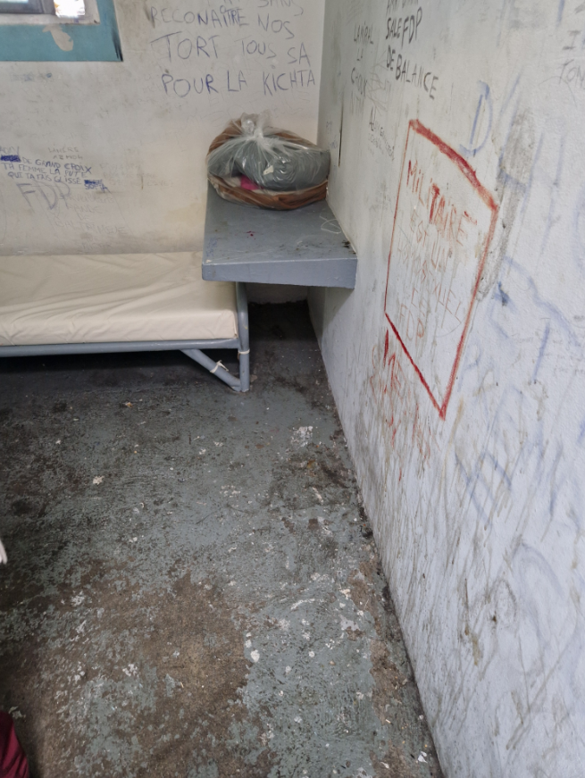
Degrading living conditions exacerbated by dilapidated and unsanitary conditions
Saint Etienne,
November 2022.
Pictures taken during the visit of the Member of the Parliament Andrée Taurinya

Slide 12
THE Lack of a coherent long-term strategy
According to its last plan of action,
the strategy of the French Government consists of :
Waiting more for the results of a reform voted in 2018
Waiting for the results of a reform adopted in December 2021 :
- 6 000 detainees
+ 10 000 detainees

Slide 13
The inefficiency of construction on overcrowding
For more than 30 years, the policy of construction of new prison places failed to address the structural prison overcrowding.
The French action plan still keeps going on with this “solution”.
Number of detainees
Number of prison places
Official statistics published by the Government

Slide 14
The LACK of new legislative measures
“that would regulate the prison population
in a more restrictive manner”
(Committee of Ministers, September 2021)

Slide 15
Recommendations (> Rule 9 - OIP’S Communication)
Establishing a binding prison regulation mechanism
According to a reformed calculation method
Adopting a national action plan ensuring the definitive reduction of prison overcrowding
According to the Council of Europe’s recommendations, including
decriminalisation of certain types of offences
reducing the use of pre-trial detention
replacing of short prison sentences by non custodial sanctions
reducing the length of the sentence served…
Discontinuing prison expansion programmes and reviewing budgetary priorities

Slide 16
II. The ineffectiveness of the remedies

Slide 17
The committee of ministers’ decision – September 2021
Invited the authorities to pronounce themselves “on the concerns expressed about the new legal remedy”, in particular on:
“the timeframes for the examination of the remedy in practice
and the role given to the administration and the "transfers" it may decide on, without verification by the judge of the new conditions of detention”

Slide 18
ISSUES IDENTIFIED WITH REGARD TO THE NEW JUDICIAL REMEDY
No assessment tool of its efficacy
Recommendation: public data on the remedy and creation of monitoring tools
Some detainees can’t benefit from it
Not an effective remedy to put an end to prison overcrowding

Slide 19
The bordeaux prison (June 2022 visit)
© CGLPL

Slide 20
ISSUES IDENTIFIED WITH REGARD TO THE NEW JUDICIAL REMEDY
No assessment tool of its efficacy
Some detainees can’t benefit from it
Not an effective remedy to put an end to prison overcrowding
Recommendation: reinforcement of the effectiveness of the remedy
© CGLPL
Bordeaux, June 2022

Slide 21
THE BORDEAUX PRISON: CELL N°625
“The manifestly illegal nature of the violation of the [detainees’] fundamental freedoms must be assessed in light of the resources available to the authorities”
“The living conditions in this cell do not constitute inhuman and degrading treatment”
Bordeaux administrative court,
November 9th, 2022
September
2022

Slide 22
The REFERE-LIBERTE
2 issues identified by the ECHR and still remaining today:
Failure to order sufficient measures
Delays with regard to the execution of the injunctions issued
More than 2 years in New Caledonia
Recommendations
Expansion of the scope of measures a judge can order
Reinforcement of the execution procedures
© CGLPL
Noumea (New Caledonia), November 2019

Slide 23
The implementation of the injunctions
“Référé-liberté” decision
First way: the classic procedure
Second way: the fast-track procedure
2-3 years to get the execution
Proof of the non-implementation?
No information given by the administration
The judge refuses to check if the decision has been implemented
No access to administrative documents
2-3 years to get a judgment

Slide 24
RECOMMENDATIONS
On prison overcrowding
Establishing a binding prison regulation mechanism
Adopting a national action plan ensuring the definitive reduction of prison overcrowding
Discontinuing prison expansion programmes and revising budgetary priorities
On the new judicial remedy
Creating monitoring tools to assess the effectiveness of the remedy
Reinforcing the effectiveness of the remedy
On the preexisting “référé-liberté”
Expanding the scope of measures a judge can order
Reinforcing the execution procedures

