Slide 1
Briefing: Implementation of Fedorchenko and Lozenko v Ukraine
Strasbourg
25 February 2019

Slide 2
2018: A Violent Year for Romani Communities in Ukraine Members of the far-right Azov National Druzhyna militia rally in December 2017.

Slide 3
2018: A Violent Year for Romani Communities in Ukraine
1. 21 April 2018, Lysa Hora Nature Reserve, Kyiv
This is still on Facebook now.

Slide 4
2018: A Violent Year for Romani Communities in Ukraine
2. 10 May 2018, Lviv
Hooliganism?

Slide 5
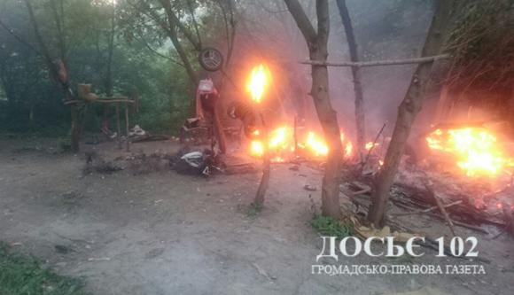
2018: A Violent Year for Romani Communities in Ukraine
3. 22 May 2018, Ternopil’

Slide 6
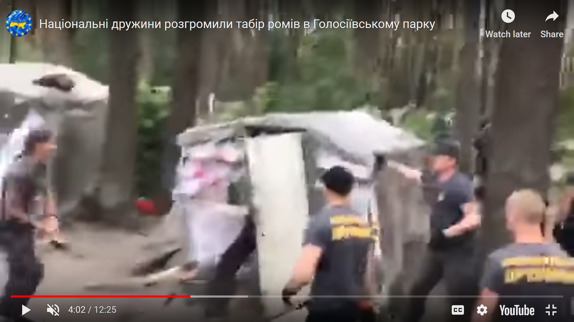
2018: A Violent Year for Romani Communities in Ukraine
4. 7 June 2018, Holosiyivskiy Park, Kyiv
The entire 12-minute video is available on You Tube. You can watch it here. This is considered “hooliganism”.
https://www.youtube.com/watch?v=X73xIGsQLvw&feature=youtu.be

Slide 7
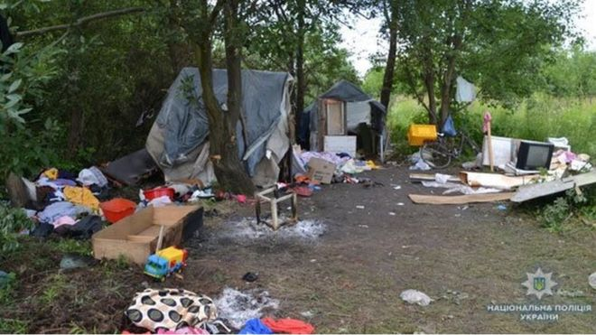
2018: A Violent Year for Romani Communities in Ukraine
5. 23 June 2018, Lviv

Slide 8
And that was just 2018
2016 and 2017 incidents have already given rise to police failures we are taking to the European Court of Human Rights
On 29 January 2019 a domestic NGO, with ERRC support, lodged a case with the administrative courts against the Ukrainian government and Interior Minister for systemic failures of police.
We expect all these individual cases and the large-scale case to end up in the European Court of Human Rights as a result of the failure to implement the Fedorchenko judgment.

Slide 9
Current Efforts – Cooperation with Civil Society
Ministry of Interior Working Group
Chiricli gave 8 trainings to police officers on communication with Romani communities
Need for futher training
Need for psychological support and security arrangements for victms (especially at night)
Need to provide financing to make Roma Integration Strategy 2020 a reality – currently massively underfunded

Slide 10
Need to Change Article 161 § 2
The same actions accompanied with violence, deception, or threats, as well as hate crimes or murders, which are based on national hatred, and also committed by an official, shall be punishable by a fine of 200 to 500 tax-free minimum incomes, or restraint of liberty for a term of two to five years, wit our without the deprivation of the right to occupy certain positions or engage in certain activities for a term of up to three years.

Slide 11
What Ukraine Must Do
Amend Article 161 § 2 of the Criminal Code
Regular reporting to the Committee of Ministers on current hate crime cases (including these five)
Effective training of law enforcement
Oversight structure for dealing with hate crimes
Strengthened mechanisms for complaints against police
Report to the Committee of Ministers on the budgets and financing for related aspects of Roma Integration Strategy 2020

Slide 12
Thank you!
vivien.brassoi@errc.org
lina_kondur@yahoo.com
adam.weiss@errc.org

